Slide 1
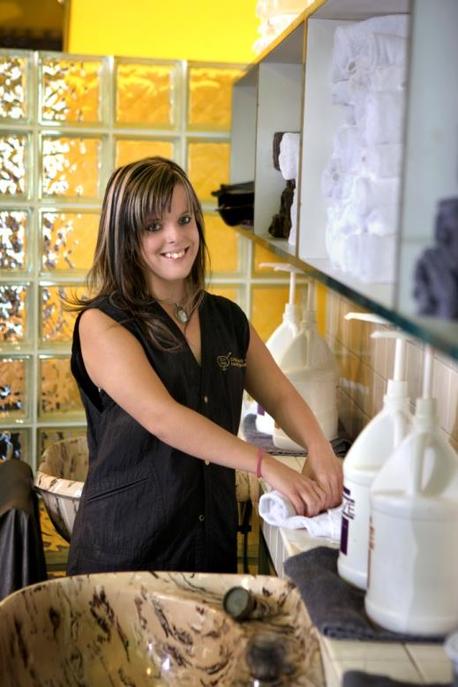
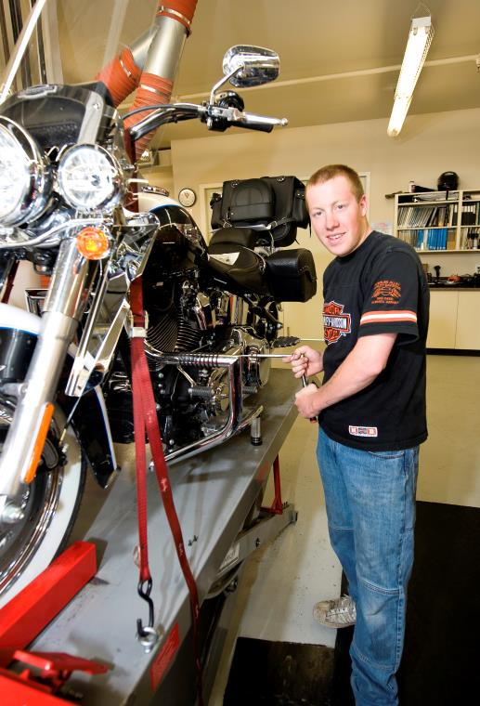
Registered Apprenticeship Program
Holly
Trade – Hairstylist
Taylor
Trade – Motorcycle Mechanic

Slide 2
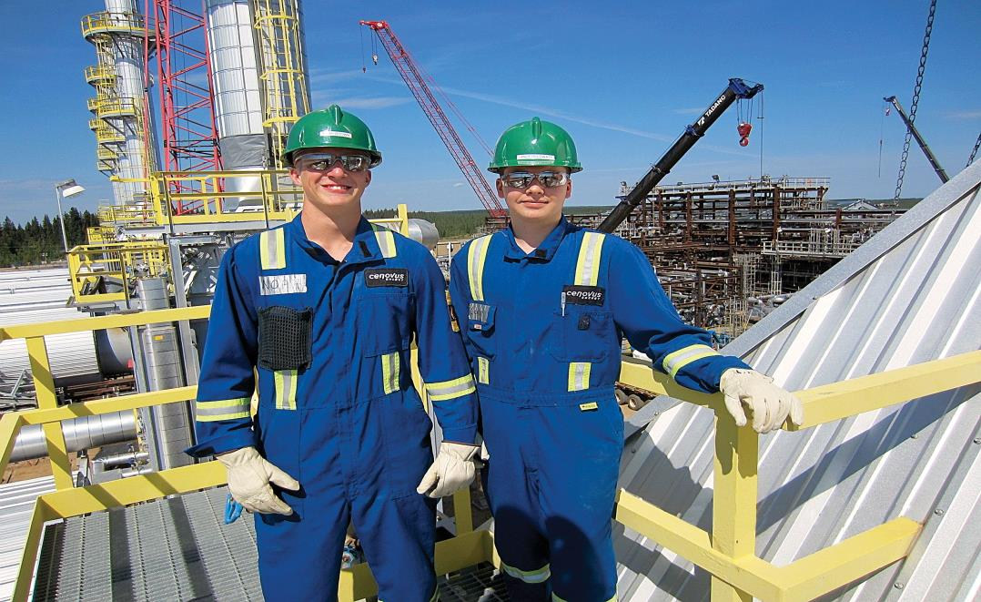
Registered Apprenticeship Program
Trade: Steamfitter/ Pipefitter
Earn while you learn

Slide 3
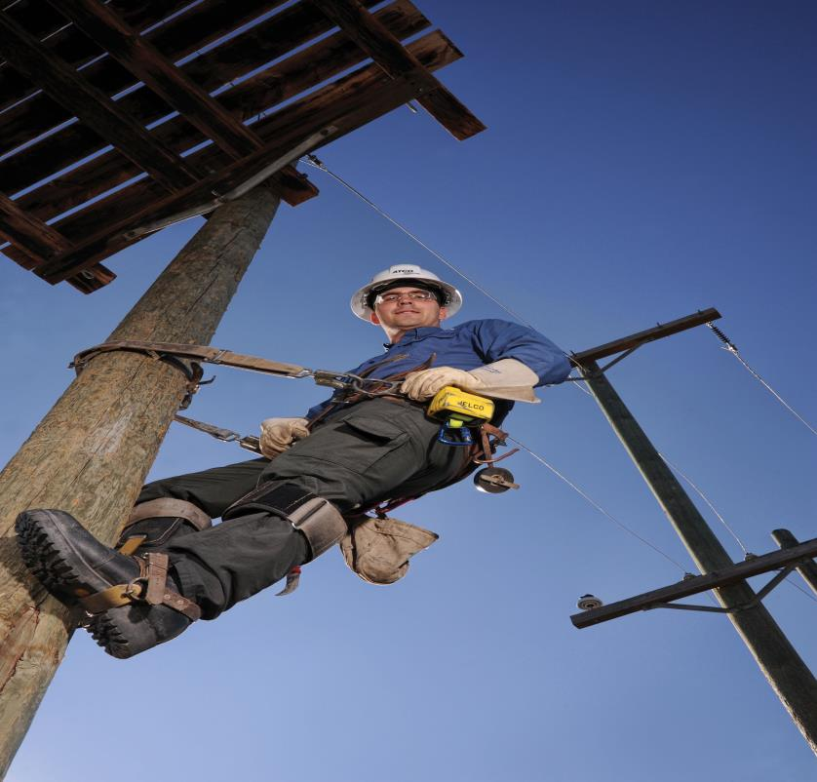
Registered Apprenticeship Program
Trade:
Powerline Tech
On the Job CERTIFIED TRAINING

Slide 4
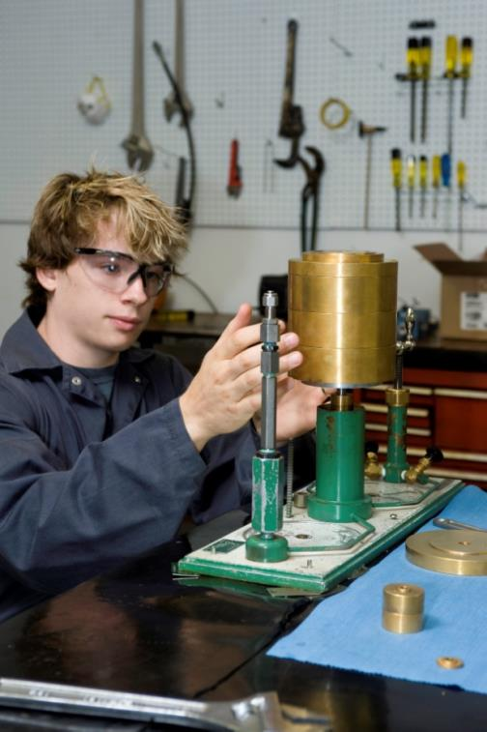
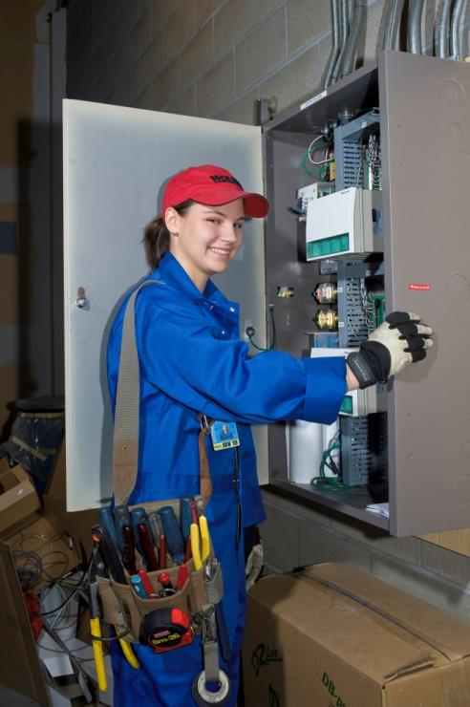
Registered Apprenticeship Program
Julian
Trade – Instrument Tech
Stephanie:
Trade - Electrician

Slide 5
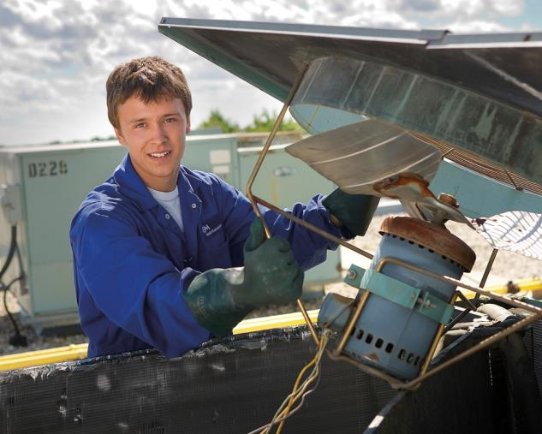

Registered Apprenticeship Program
Jared
Trade – Refrigeration and A/C Mechanic
Abigail
Trade – Instrument Tech

Slide 6
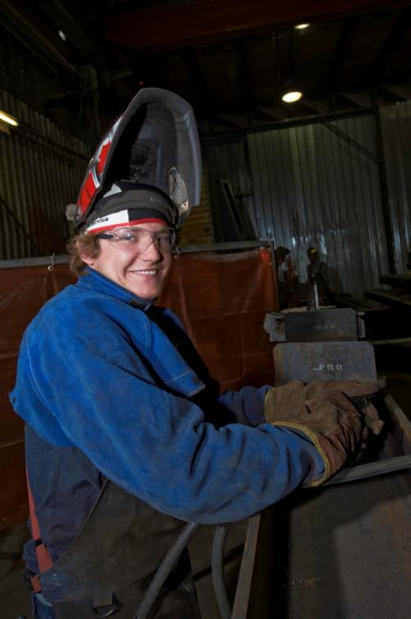
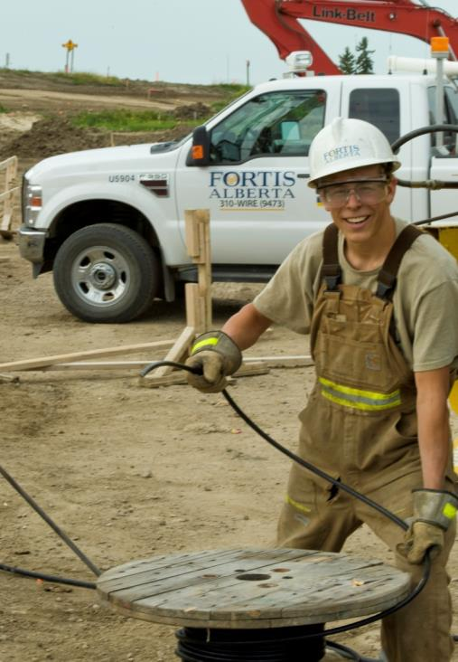
Registered Apprenticeship Program
Tyler
Trade - Welder
Nolan
Trade – Powerline Tech

Slide 7
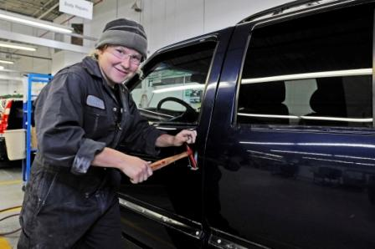
Registered Apprenticeship Program
Diva
Trade – Auto Body Tech

Slide 8
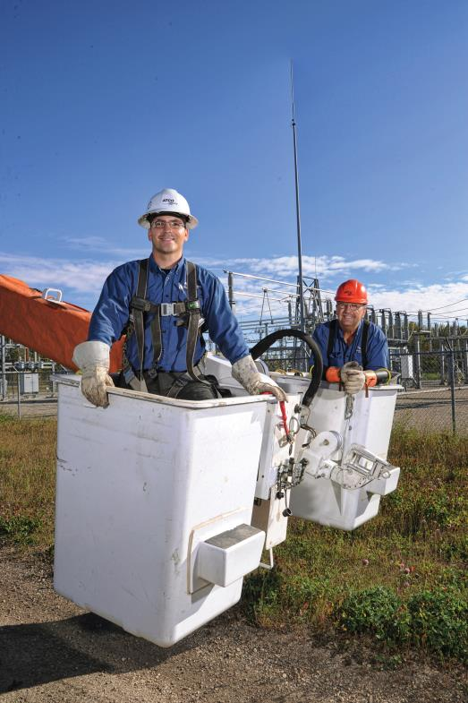
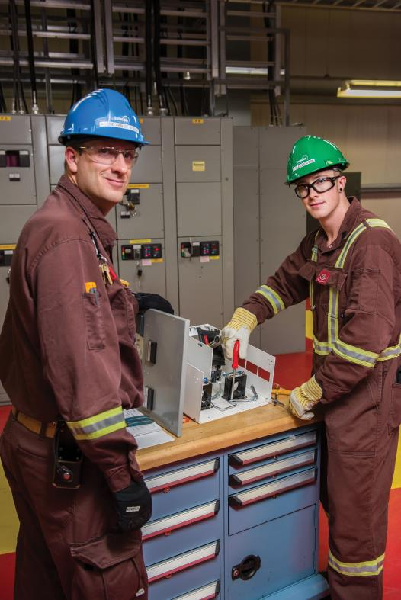
Registered Apprenticeship Program
Trade: Powerline Tech
Trade: Instrument Tech

Slide 9
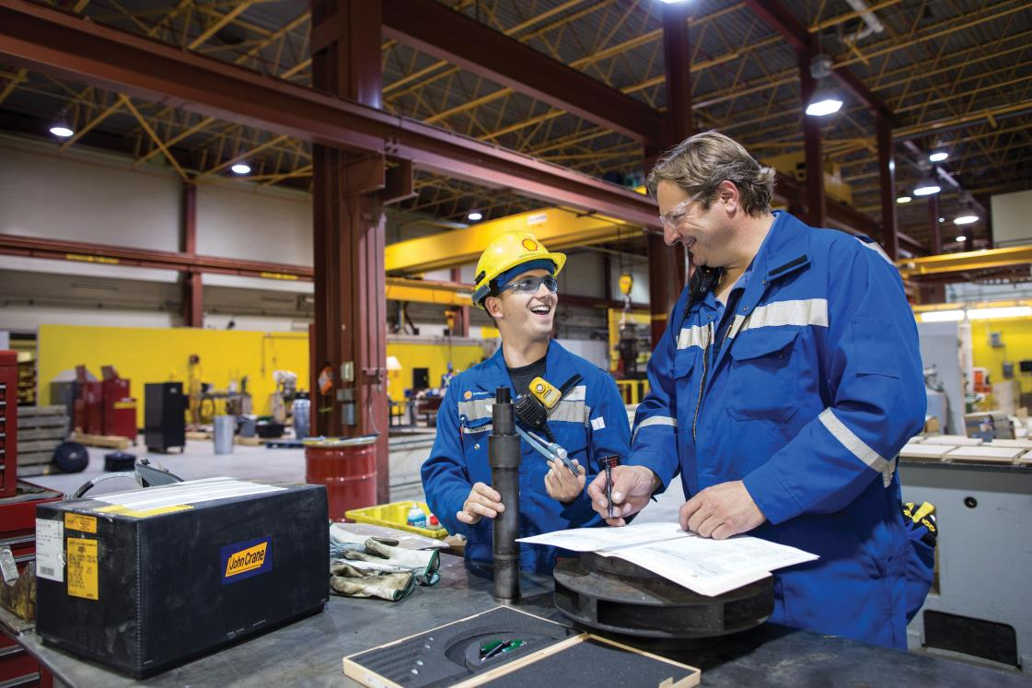
Registered Apprenticeship Program
Millwright Apprentice and Journeyperson
…Mentorship, training and guidance.

Slide 10

Registered Apprenticeship Program
Success at an early age…
for both boys and girls!

Slide 11
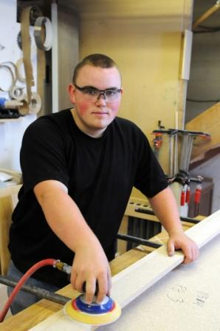
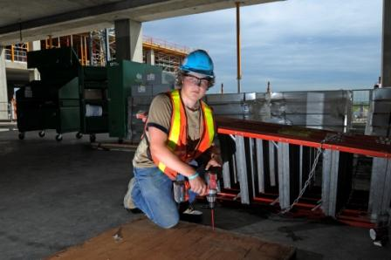
Registered Apprenticeship Program
Graham
Trade - Electrician
Michael
Trade - Carpenter

Slide 12
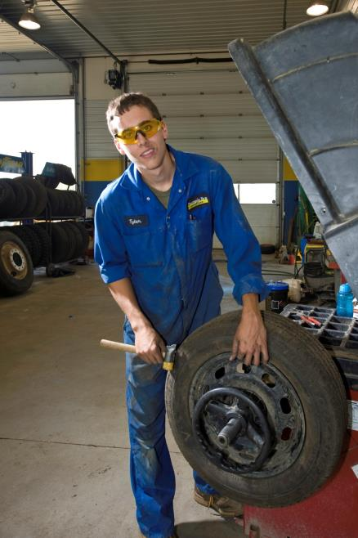
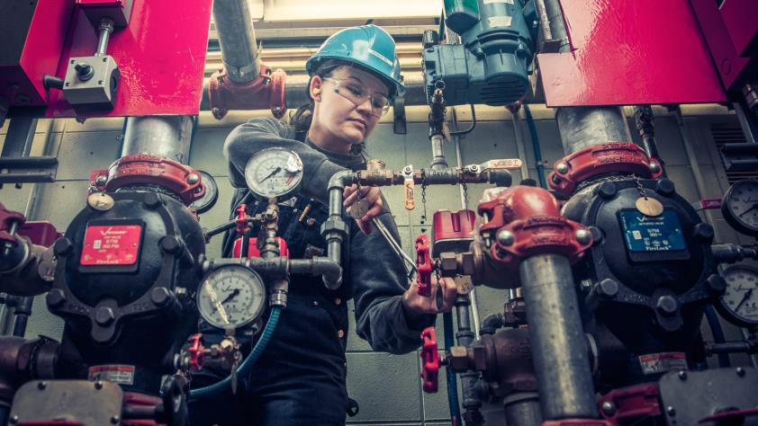
Registered Apprenticeship Program
Trade – Sprinkler System Installer
Tyler
Trade – Auto Service Tech

Slide 13

Registered Apprenticeship Program
Trade – Lather- Interior Systems Mechanic

Slide 14

Registered Apprenticeship Program
Trade – Sheet Metal Worker

Slide 15
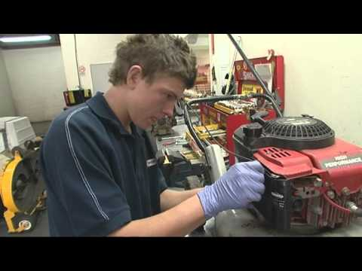
Registered Apprenticeship Program
Trade – Outdoor Power Equipment Tech

Slide 16
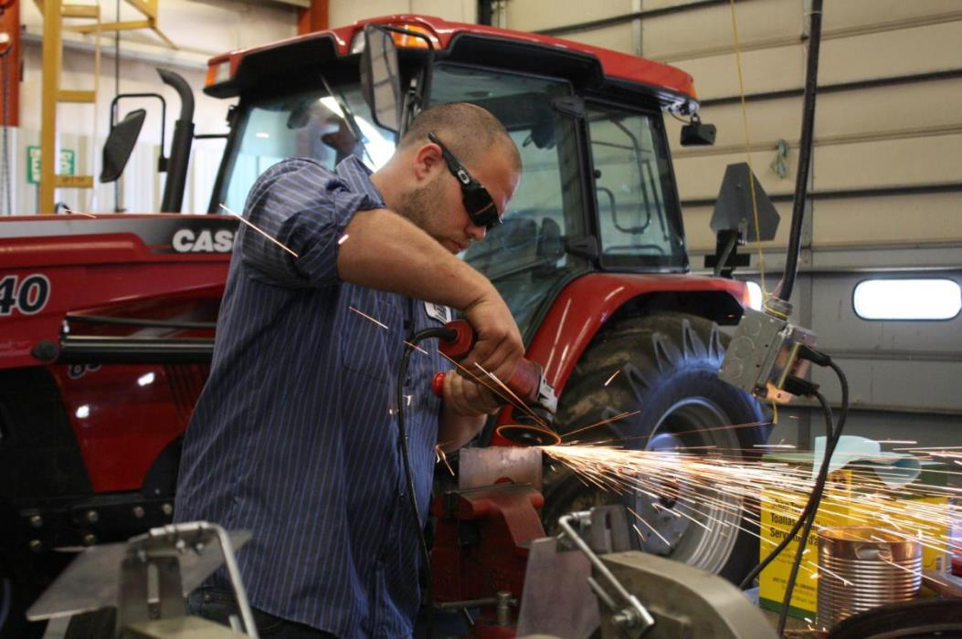
Registered Apprenticeship Program
Trade – Agricultural Equipment Tech

Slide 17
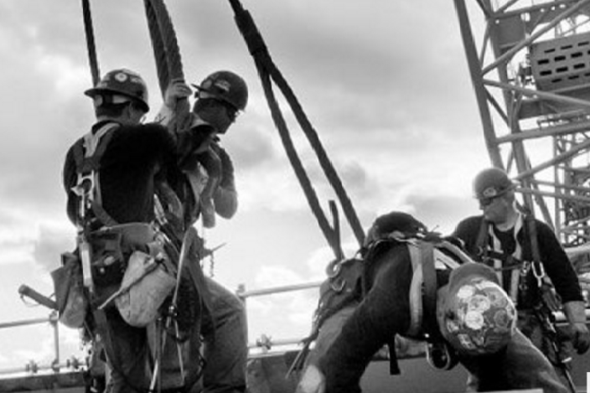
Registered Apprenticeship Program
Trade – Ironworker

Slide 18
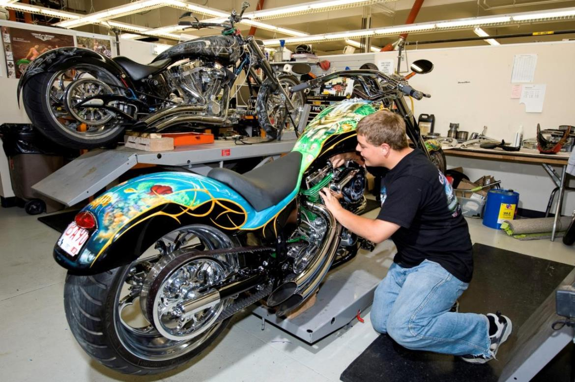
Registered Apprenticeship Program
Trade – Motorcycle Mechanic

Slide 19
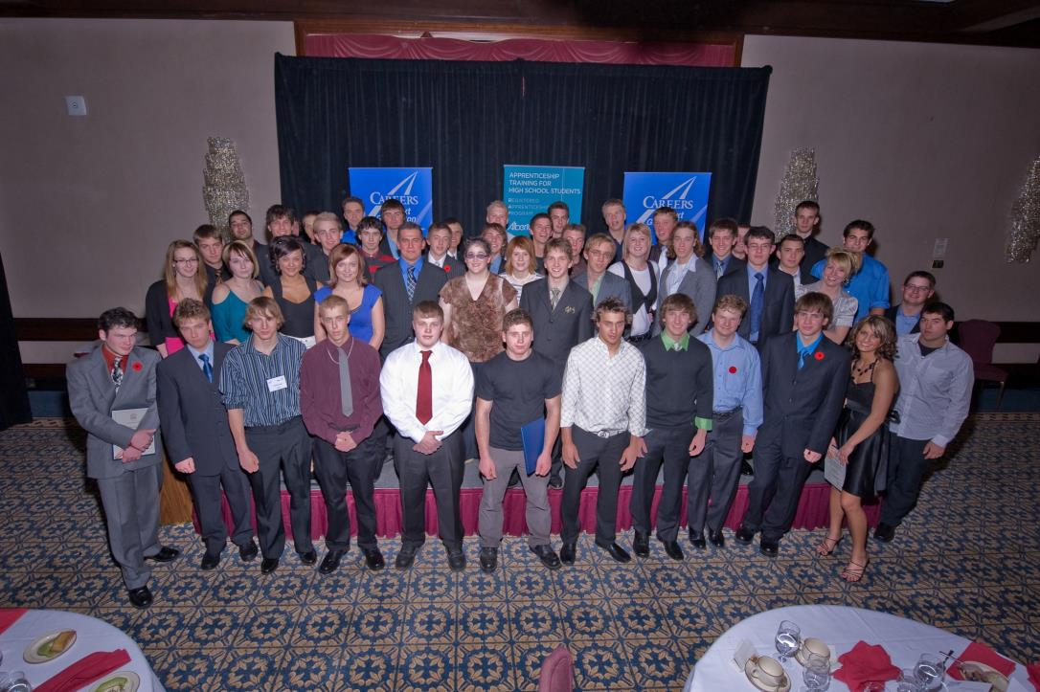
Registered Apprenticeship Program
$1,000 Scholarships available !

Slide 20
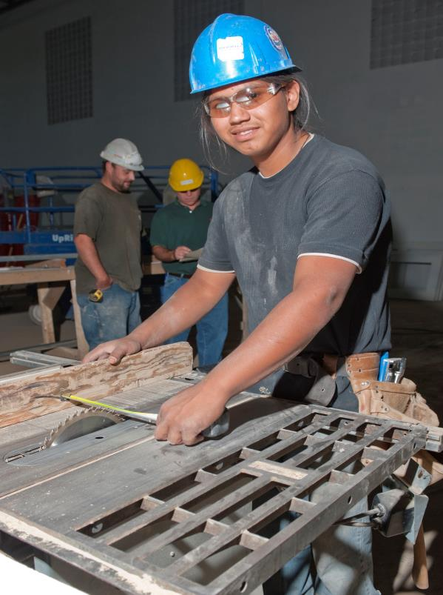
CAREERS Indigenous Career Pathways
Storm
Trade - Carpenter

Slide 21
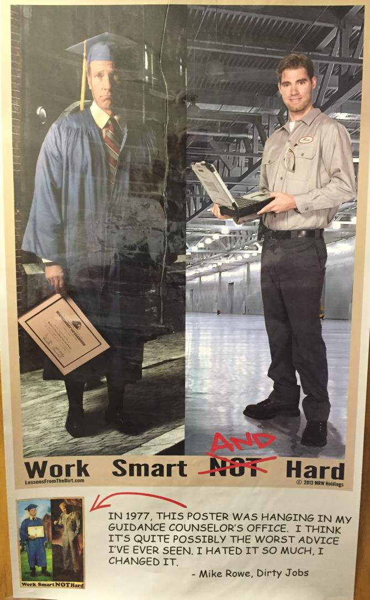

Slide 22

Registered Apprenticeship Program
Discover YOUR passion….and get started today!

Slide 23


Valuable Resources
CAREERS: The Next Generation
www.nextgen.org
http://www.tradesalberta.ca/
Trades Secrets
http://tradesecrets.alberta.ca/
Alis (Alberta Learning Information Services)
http://alis.alberta.ca/index.html
Search videos on YouTube…
“A Day in the life of….(your trade)…”

